Slide 1
eMasters – Communication Systems E920 Wireless Communications
Notes, References, Questions, Problems, and Solutions
Venkateswar Reddy Melachervu
Jan 2023

Slide 2
Lecture 1

Slide 3
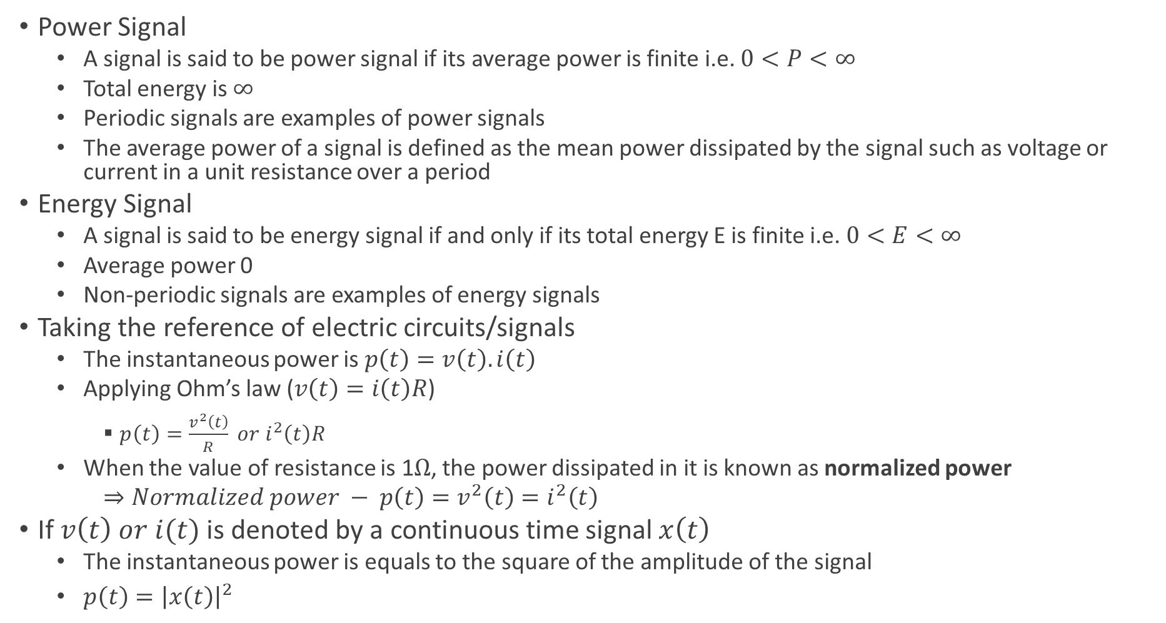
Key Concepts in Signal Processing
Power Signal
A signal is said to be power signal if its average power is finite i.e. $0<P<∞$
Total energy is $∞$
Periodic signals are examples of power signals
The average power of a signal is defined as the mean power dissipated by the signal such as voltage or current in a unit resistance over a period
Energy Signal
A signal is said to be energy signal if and only if its total energy E is finite i.e. $0<E<∞$
Average power 0
Non-periodic signals are examples of energy signals
Taking the reference of electric circuits/signals
The instantaneous power is $p\left(t\right)=v\left(t\right).i\left(t\right)$
Applying Ohm’s law ($v\left(t\right)=i\left(t\right)R$)
$p\left(t\right)=\frac{v^{2}\left(t\right)}{R} or i^{2}\left(t\right)R$
When the value of resistance is 1$Ω$, the power dissipated in it is known as normalized power
$⇒Normalized power − p\left(t\right)=v^{2}\left(t\right)=i^{2}\left(t\right)$
If $v\left(t\right) or i(t)$ is denoted by a continuous time signal $x\left(t\right)$
The instantaneous power is equals to the square of the amplitude of the signal
$p\left(t\right)={\left|x\left(t\right)\right|}^{2}$

Slide 4
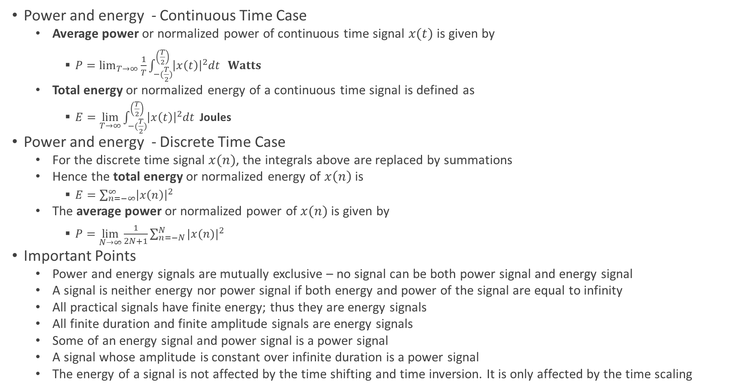
Key Concepts in Signal Processing
Power and energy - Continuous Time Case
Average power or normalized power of continuous time signal $x(t)$ is given by
$P=\lim_{T→∞}{\frac{1}{T}\int_{−(\frac{T}{2})}^{\left(\frac{T}{2}\right)}{{\left|x\left(t\right)\right|}^{2}dt} } Watts$
Total energy or normalized energy of a continuous time signal is defined as
$E=\lim_{T→∞}{\int_{−(\frac{T}{2})}^{\left(\frac{T}{2}\right)}{{\left|x\left(t\right)\right|}^{2}dt} }$Joules
Power and energy - Discrete Time Case
For the discrete time signal $x(n)$, the integrals above are replaced by summations
Hence the total energy or normalized energy of $x\left(n\right)$ is
$E=\sum_{n=−∞}^{∞}{{\left|x\left(n\right)\right|}^{2}}$
The average power or normalized power of $x(n)$ is given by
$P=\lim_{N→∞}{\frac{1}{2N+1}\sum_{n=−N}^{N}{{|x(n)|}^{2}}}$
Important Points
Power and energy signals are mutually exclusive – no signal can be both power signal and energy signal
A signal is neither energy nor power signal if both energy and power of the signal are equal to infinity
All practical signals have finite energy; thus they are energy signals
All finite duration and finite amplitude signals are energy signals
Some of an energy signal and power signal is a power signal
A signal whose amplitude is constant over infinite duration is a power signal
The energy of a signal is not affected by the time shifting and time inversion. It is only affected by the time scaling

Slide 5
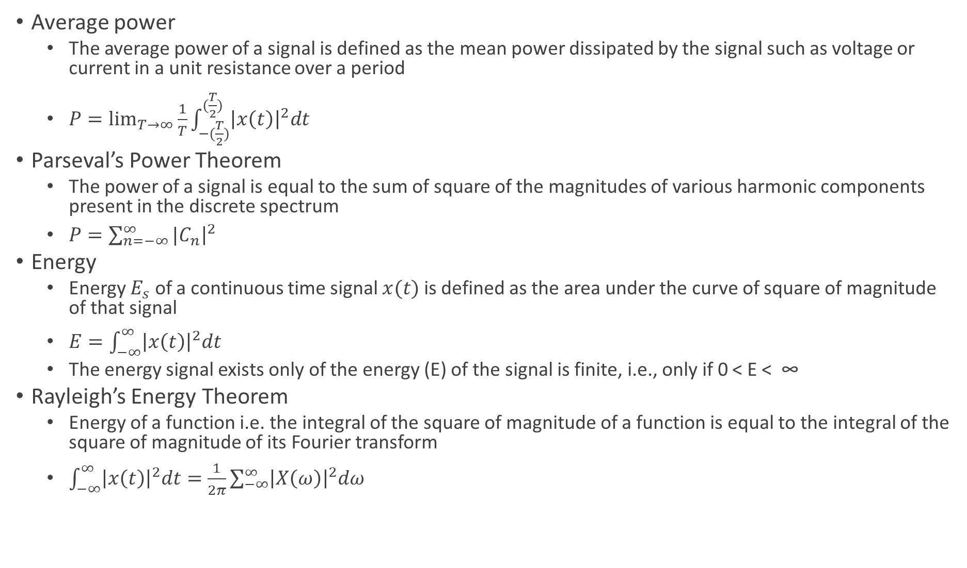
Key Concepts in Signal Processing
Average power
The average power of a signal is defined as the mean power dissipated by the signal such as voltage or current in a unit resistance over a period
$P=\lim_{T→∞}{\frac{1}{T}\int_{−(\frac{T}{2})}^{(\frac{T}{2})}{{\left|x\left(t\right)\right|}^{2}dt}}$
Parseval’s Power Theorem
The power of a signal is equal to the sum of square of the magnitudes of various harmonic components present in the discrete spectrum
$P=\sum_{n=−∞}^{∞}{{|C}_{n}{\left.​\right|}^{2}}$
Energy
Energy $E_{s}$ of a continuous time signal $x(t)$ is defined as the area under the curve of square of magnitude of that signal
$E=\int_{−∞}^{∞}{{\left|x\left(t\right)\right|}^{2}dt}$
The energy signal exists only of the energy (E) of the signal is finite, i.e., only if 0 < E < ∞
Rayleigh’s Energy Theorem
Energy of a function i.e. the integral of the square of magnitude of a function is equal to the integral of the square of magnitude of its Fourier transform
$\int_{−∞}^{∞}{{\left|x\left(t\right)\right|}^{2}dt=\frac{1}{2π}\sum_{−∞}^{∞}{{\left|X\left(ω\right)\right|}^{2}dω}}$

Slide 6
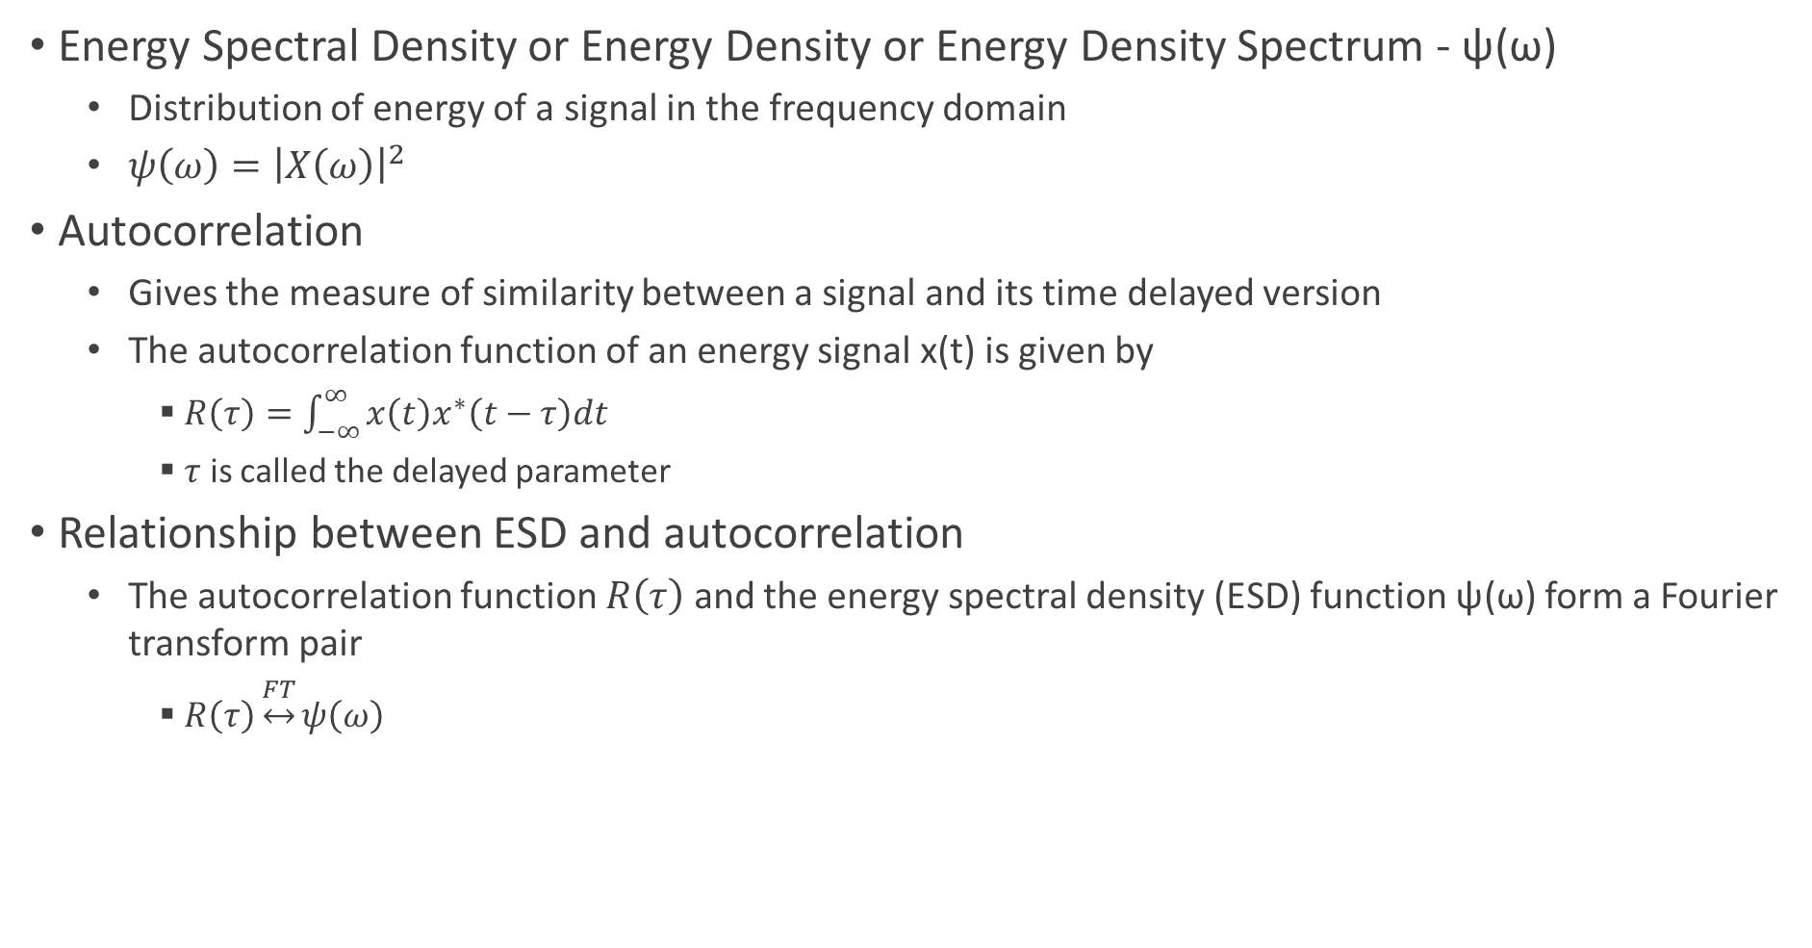
Energy Spectral Density and Autocorrelation
Energy Spectral Density or Energy Density or Energy Density Spectrum - ψ(ω)
Distribution of energy of a signal in the frequency domain
$ψ\left(ω\right)={\left|X\left(ω\right)\right|}^{2}$
Autocorrelation
Gives the measure of similarity between a signal and its time delayed version
The autocorrelation function of an energy signal x(t) is given by
$R\left(τ\right)=\int_{−∞}^{∞}{x\left(t\right)x^{∗}\left(t−τ\right)dt}$
$τ$ is called the delayed parameter
Relationship between ESD and autocorrelation
The autocorrelation function $R\left(τ\right)$ and the energy spectral density (ESD) function ψ(ω) form a Fourier transform pair
$R\left(τ\right)\underset{↔}{FT}ψ\left(ω\right)$

Slide 7
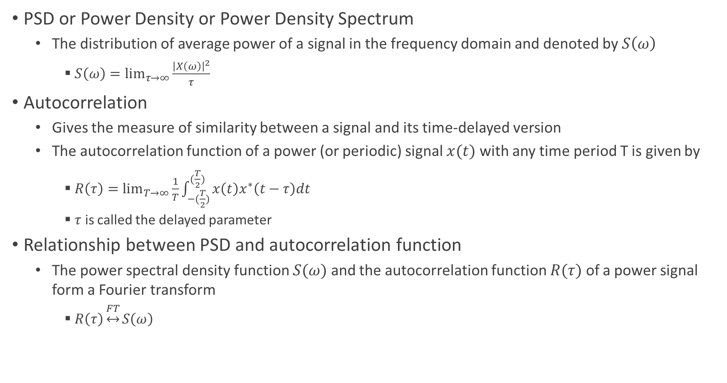
Power Spectral Density and Autocorrelation
PSD or Power Density or Power Density Spectrum
The distribution of average power of a signal in the frequency domain and denoted by $S\left(ω\right)$
$S\left(ω\right)=\lim_{τ→∞}{\frac{{\left|X\left(ω\right)\right|}^{2}}{τ}}$
Autocorrelation
Gives the measure of similarity between a signal and its time-delayed version
The autocorrelation function of a power (or periodic) signal $x(t)$ with any time period T is given by
$R\left(τ\right)=\lim_{T→∞}{\frac{1}{T}\int_{−(\frac{T}{2})}^{(\frac{T}{2})}{x\left(t\right)x^{∗}\left(t−τ\right)dt}}$
$τ$ is called the delayed parameter
Relationship between PSD and autocorrelation function
The power spectral density function $S(ω)$ and the autocorrelation function $R(τ)$ of a power signal form a Fourier transform
$R\left(τ\right)\underset{↔}{FT}S\left(ω\right)$

Slide 8
Modern Communication Technologies and Systems
Cutting edge wireless technologies
Multiple Antennae Systems
Multiple Input and Multiple Output - MIMO Technology
OFDM – Orthogonal Frequency Division Multiplexing
Large bandwidth divided into several sub-bands and multiple uses sub-carriers
CDMA
Spreading code
Modern cellular and wifi systems built on cutting edge wireless technologies
LTE
5G – NR
802.11 AC, 802.11 AX

Slide 9
Principles and Models of Modern Wireless Systems

Slide 10
Basic Digital Communication

Slide 11

Modern Wireline Digital Communication System
Four components
Received signal y
Transmitted signal x
Noise n
Channel
Signal to Noise Power Ratio
Simple model of a communication system
$y=x+n$
n – Additive noise
Signal power
Defined as
$E\left\{{\left|x\right|}^{2}\right\}=P$ - power
$E\left\{∗\right\} −Expected value or average$ E is expectation operator

Slide 12
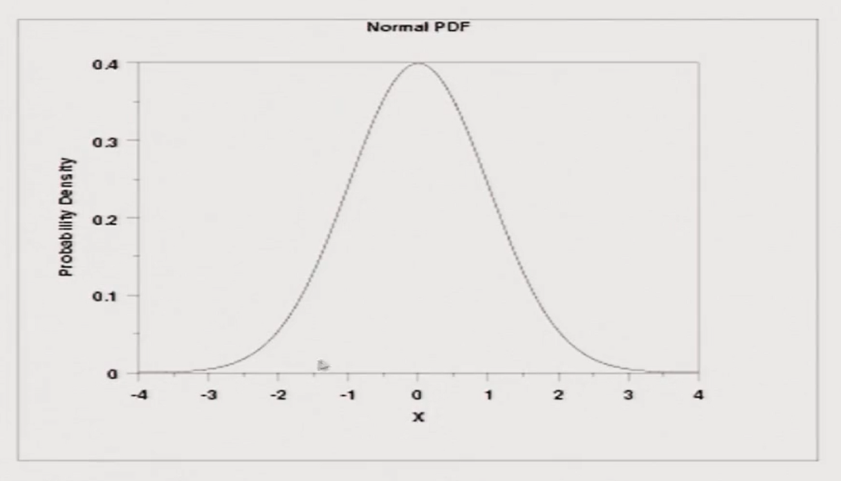
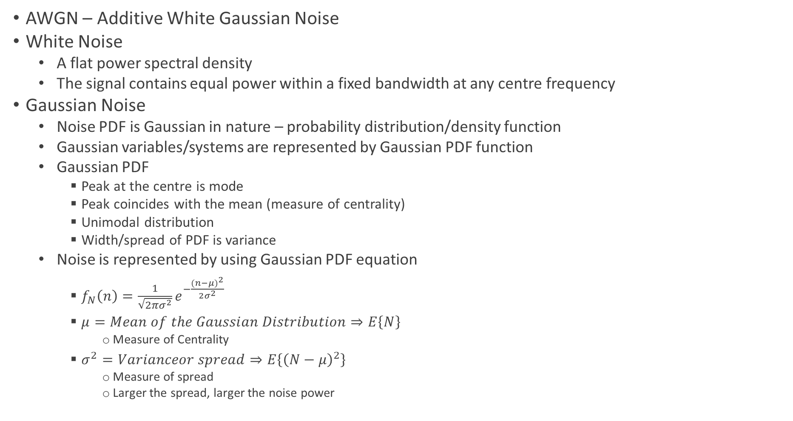
Gaussian Random Variable and PDF
AWGN – Additive White Gaussian Noise
White Noise
A flat power spectral density
The signal contains equal power within a fixed bandwidth at any centre frequency
Gaussian Noise
Noise PDF is Gaussian in nature – probability distribution/density function
Gaussian variables/systems are represented by Gaussian PDF function
Gaussian PDF
Peak at the centre is mode
Peak coincides with the mean (measure of centrality)
Unimodal distribution
Width/spread of PDF is variance
Noise is represented by using Gaussian PDF equation
$f_{N}\left(n\right)=\frac{1}{\sqrt{2πσ^{2}}}e^{−\frac{{(n−μ)}^{2}}{2σ^{2}}}$
$μ=Mean of the Gaussian Distribution⇒E\left\{N\right\}$
Measure of Centrality
$σ^{2}=Varianceor spread⇒E\left\{{\left(N−μ\right)}^{2}\right\}$
Measure of spread
Larger the spread, larger the noise power

Slide 13

Additive Gaussian Noise
$Gaussing White Noise$
$f_{N}\left(n\right)=\frac{1}{\sqrt{2πσ^{2}}}e^{−\frac{{(n−μ)}^{2}}{2σ^{2}}}$
Typically $mean μ=0$ for noise
$$⇒f_{N}\left(n\right)=\frac{1}{\sqrt{2πσ^{2}}}e^{−\frac{n^{2}}{2σ^{2}}}$$
$σ^{2} is considered as noise power and is equivalent to:$
$\frac{N_{0}}{2}=Noise Power Spectral Density$
$σ^{2}$ = $\frac{N_{0}}{2}=Variance= E\{{|N|}^{2}\}$

Slide 14
Lecture 2

Slide 15

White Noise
Noise PSD (Power Spectral Density) is flat across the entire frequency spectrum
$⇒S_{nn}\left(Ω\right)(PSD)=\frac{N_{0}}{2}=Constant$
Power distribution is uniform across all frequency components - Similar to white light
Contains all the frequency components

Slide 16
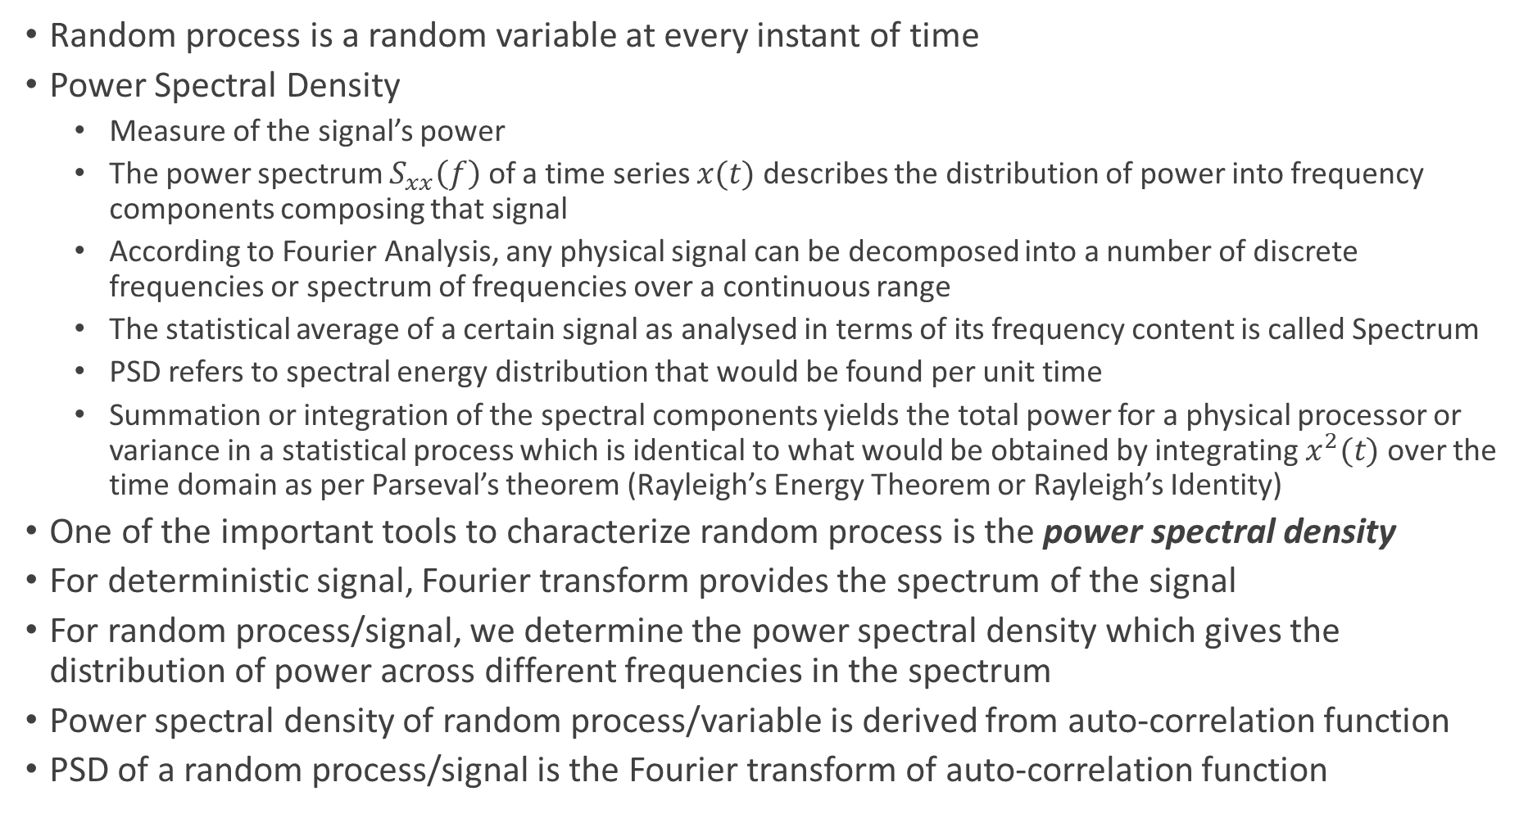
Random Process Characterization - Power Spectral Density
Random process is a random variable at every instant of time
Power Spectral Density
Measure of the signal’s power
The power spectrum $S_{xx}\left(f\right)$ of a time series $x(t)$ describes the distribution of power into frequency components composing that signal
According to Fourier Analysis, any physical signal can be decomposed into a number of discrete frequencies or spectrum of frequencies over a continuous range
The statistical average of a certain signal as analysed in terms of its frequency content is called Spectrum
PSD refers to spectral energy distribution that would be found per unit time
Summation or integration of the spectral components yields the total power for a physical processor or variance in a statistical process which is identical to what would be obtained by integrating $x^{2}(t)$ over the time domain as per Parseval’s theorem (Rayleigh’s Energy Theorem or Rayleigh’s Identity)
One of the important tools to characterize random process is the power spectral density
For deterministic signal, Fourier transform provides the spectrum of the signal
For random process/signal, we determine the power spectral density which gives the distribution of power across different frequencies in the spectrum
Power spectral density of random process/variable is derived from auto-correlation function
PSD of a random process/signal is the Fourier transform of auto-correlation function

Slide 17
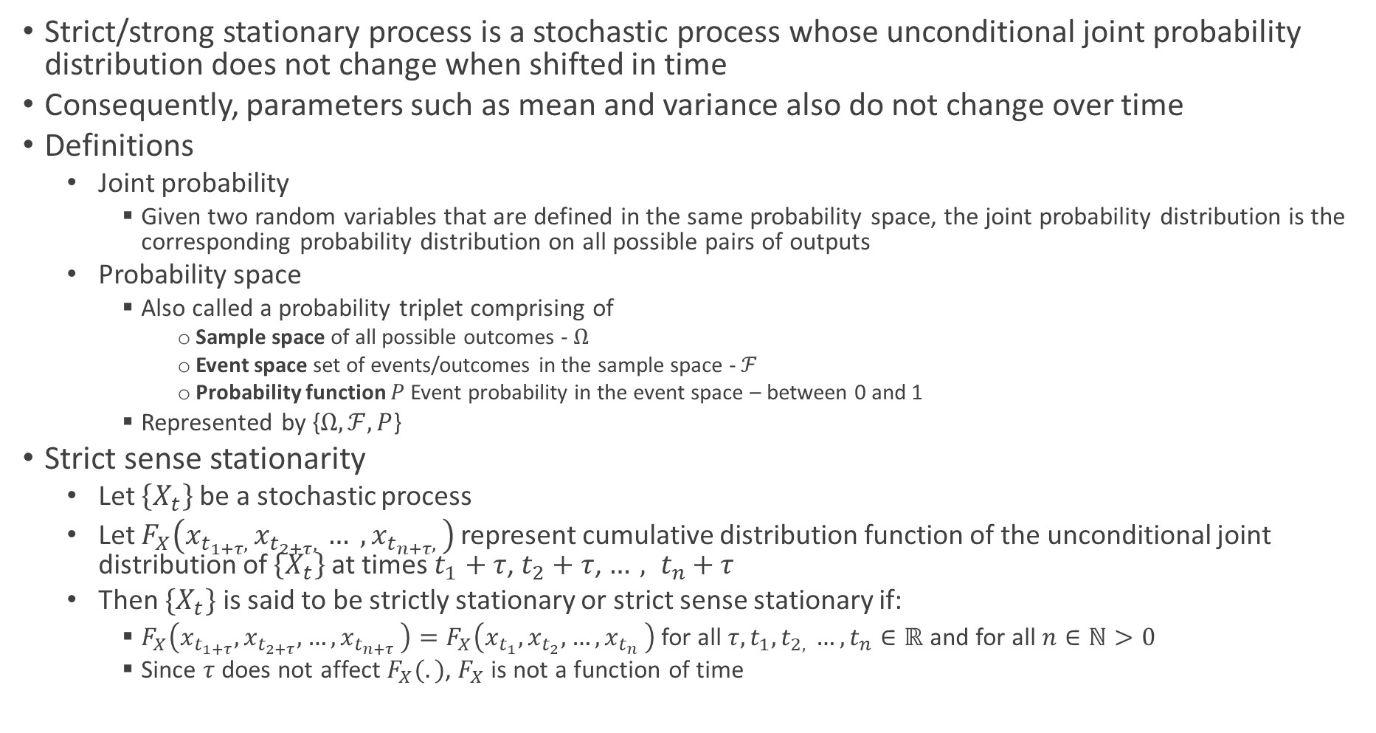
Stationary Process
Strict/strong stationary process is a stochastic process whose unconditional joint probability distribution does not change when shifted in time
Consequently, parameters such as mean and variance also do not change over time
Definitions
Joint probability
Given two random variables that are defined in the same probability space, the joint probability distribution is the corresponding probability distribution on all possible pairs of outputs
Probability space
Also called a probability triplet comprising of
Sample space of all possible outcomes - $Ω$
Event space set of events/outcomes in the sample space - $ℱ$
Probability function $P$Event probability in the event space – between 0 and 1
Represented by {$Ω, ℱ, P$}
Strict sense stationarity
Let $\left\{X_{t}\right\}$ be a stochastic process
Let $F_{X}\left(x_{t_{1+τ}, }x_{t_{2+τ}, }… , x_{t_{n+τ}, }\right)$represent cumulative distribution function of the unconditional joint distribution of $\left\{X_{t}\right\}$ at times $t_{1}+τ$, $t_{2}+τ$, ${…, t}_{n}+τ$
Then $\{X_{t}\}$ is said to be strictly stationary or strict sense stationary if:
$F_{X}\left(x_{t_{1+τ}}, x_{t_{2+τ}}, {…, x}_{t_{n+τ}}\right)=F_{X}\left(x_{t_{1}}, x_{t_{2}}, {…, x}_{t_{n}}\right)$ for all $τ, t_{1}, t_{2, }{…, t}_{n}∈ℝ$ and for all $n∈ℕ>0$
Since $τ$ does not affect $F_{X}(.)$, $F_{X}$ is not a function of time

Slide 18
PSD
PSD is a Fourier transform of auto-correlation

Slide 19
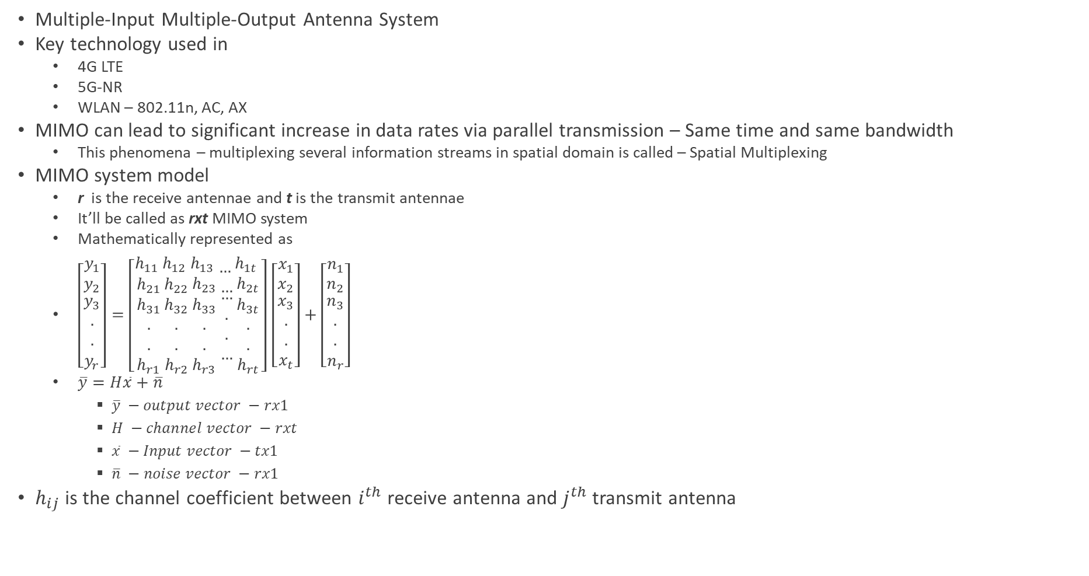
Intro to MIMO System
Multiple-Input Multiple-Output Antenna System
Key technology used in
4G LTE
5G-NR
WLAN – 802.11n, AC, AX
MIMO can lead to significant increase in data rates via parallel transmission – Same time and same bandwidth
This phenomena – multiplexing several information streams in spatial domain is called – Spatial Multiplexing
MIMO system model
r is the receive antennae and t is the transmit antennae
It’ll be called as rxt MIMO system
Mathematically represented as
$\left[\begin{matrix}y_{1} \\ y_{2} \\ \begin{aligned}y_{3} \\ . \\ . \\ y_{r}\end{aligned}\end{matrix}\right]=\left[\begin{matrix}h_{11} \\ h_{21} \\ \begin{aligned}h_{31} \\ . \\ . \\ h_{r1}\end{aligned}\end{matrix}\begin{matrix}h_{12} \\ h_{22} \\ \begin{aligned}h_{32} \\ . \\ . \\ h_{r2}\end{aligned}\end{matrix}\begin{matrix}h_{13} \\ h_{23} \\ \begin{aligned}h_{33} \\ . \\ . \\ h_{r3}\end{aligned}\end{matrix}\begin{matrix}… \\ … \\ \begin{aligned}… \\ . \\ . \\ …\end{aligned}\end{matrix}\begin{matrix}h_{1t} \\ h_{2t} \\ \begin{aligned}h_{3t} \\ . \\ . \\ h_{rt}\end{aligned}\end{matrix}\right]$ $\left[\begin{matrix}x_{1} \\ x_{2} \\ \begin{aligned}x_{3} \\ . \\ . \\ x_{t}\end{aligned}\end{matrix}\right]+\left[\begin{matrix}n_{1} \\ n_{2} \\ \begin{aligned}n_{3} \\ . \\ . \\ n_{r}\end{aligned}\end{matrix}\right]$
$\overline{y}=H\overline{x}+\overline{n}$
$\overline{y} −output vector −rx1$
$H −channel vector −rxt$
$\overline{x} −Input vector −tx1$
$\overline{n} −noise vector −rx1$
$h_{ij}$ is the channel coefficient between $i^{th}$ receive antenna and $j^{th}$ transmit antenna

Slide 20
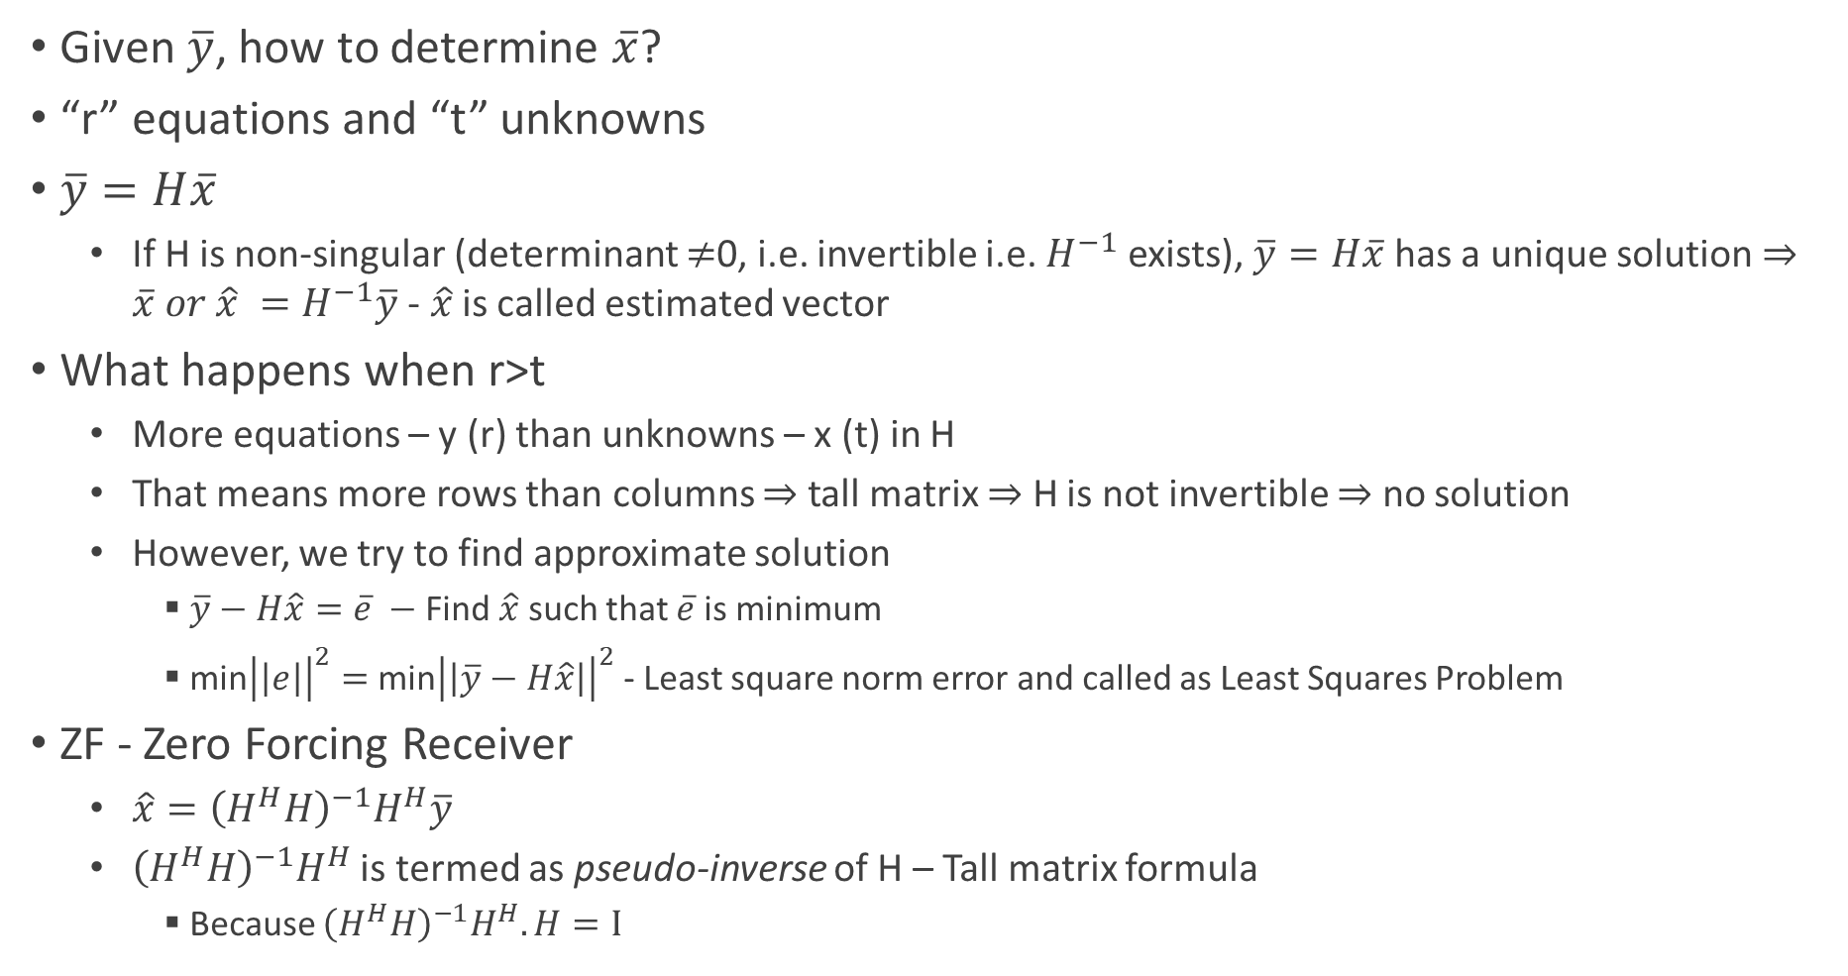
MIMO Receiver
Given $\overline{y}$, how to determine $\overline{x}$?
“r” equations and “t” unknowns
$\overline{y}=H\overline{x}$
If H is non-singular (determinant $≠$0, i.e. invertible i.e. $H^{−1}$ exists), $\overline{y}=H\overline{x}$ has a unique solution $⇒\overline{x} or \hat{x} =H^{−1}\overline{y}$ - $\hat{x}$ is called estimated vector
What happens when r>t
More equations – y (r) than unknowns – x (t) in H
That means more rows than columns $⇒$ tall matrix $⇒$ H is not invertible $⇒$ no solution
However, we try to find approximate solution
$\overline{y}−H\hat{x}=\overline{e} −$Find $\hat{x}$ such that $\overline{e}$ is minimum
min${\left|\left|e\right|\right|}^{2}=$ min${\left|\left|\overline{y}−H\hat{x}\right|\right|}^{2}$ - Least square norm error and called as Least Squares Problem
ZF - Zero Forcing Receiver
$\hat{x}={\left(H^{H}H\right)}^{−1}H^{H}\overline{y}$
${\left(H^{H}H\right)}^{−1}H^{H}$ is termed as pseudo-inverse of H – Tall matrix formula
Because ${\left(H^{H}H\right)}^{−1}H^{H}.H=I$

Slide 21
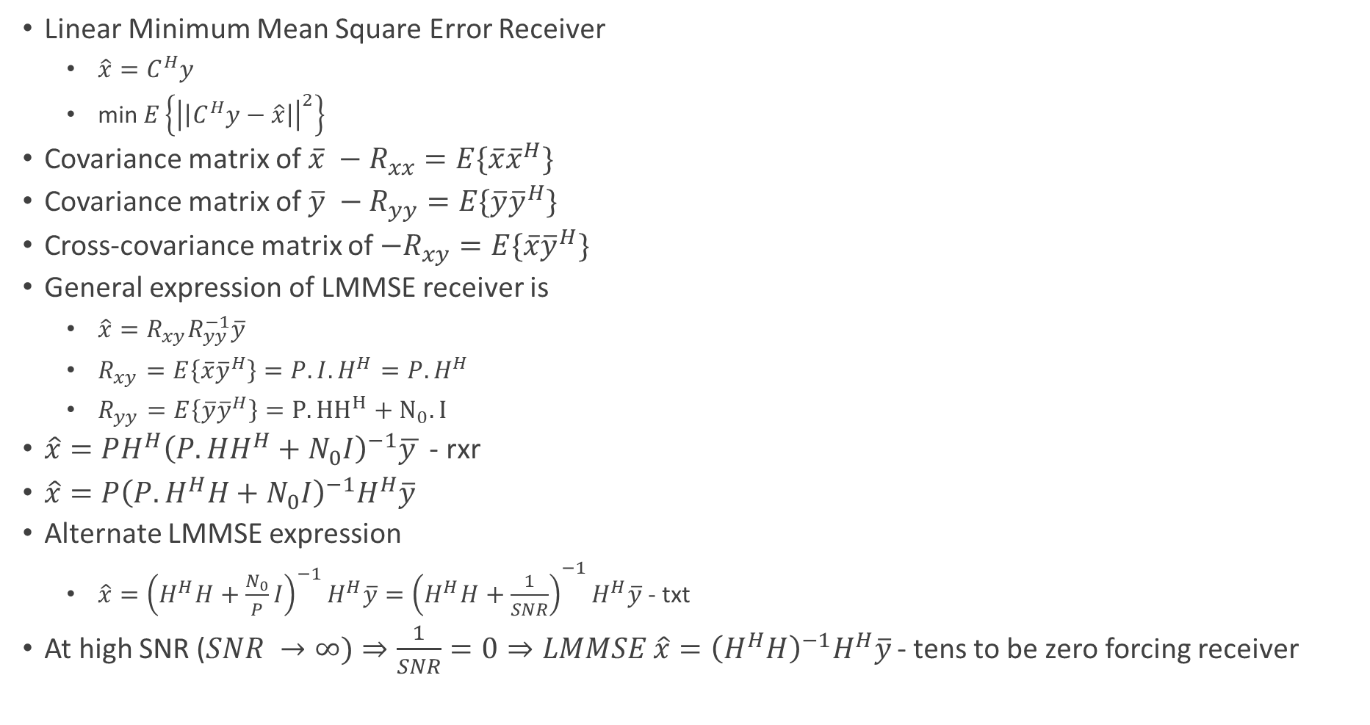
MIMO LMMSE Receiver
Linear Minimum Mean Square Error Receiver
${\hat{x}=C}^{H}y$
min$E\left\{{\left|\left|C^{H}y−\hat{x}\right|\right|}^{2}\right\}$
Covariance matrix of $\overline{x} −R_{xx}=E\{\overline{x}{\overline{x}}^{H}\}$
Covariance matrix of $\overline{y} −R_{yy}=E\{\overline{y}{\overline{y}}^{H}\}$
Cross-covariance matrix of $−R_{xy}=E\{\overline{x}{\overline{y}}^{H}\}$
General expression of LMMSE receiver is
$\hat{x}=R_{xy}R_{yy}^{−1}\overline{y}$
$R_{xy}=E\left\{\overline{x}{\overline{y}}^{H}\right\}=P.I.H^{H}=P.H^{H}$
$R_{yy}=E\left\{\overline{y}{\overline{y}}^{H}\right\}=P.{HH}^{H}+N_{0}.I$
$\hat{x}=PH^{H}{\left(P.HH^{H}+N_{0}I\right)}^{−1}\overline{y }$ - rxr
$\hat{x}=P{\left(P.H^{H}H+N_{0}I\right)}^{−1}H^{H}\overline{y}$
Alternate LMMSE expression
$\hat{x}={{\left(H^{H}H+\frac{N_{0}}{P}I\right)}^{−1}H^{H}\overline{y}=\left(H^{H}H+\frac{1}{SNR}\right)}^{−1}H^{H}\overline{y}$ - txt
At high SNR ($SNR →∞)⇒\frac{1}{SNR}=0⇒LMMSE \hat{x}={\left(H^{H}H\right)}^{−1}H^{H}\overline{y}$ - tens to be zero forcing receiver

Slide 22
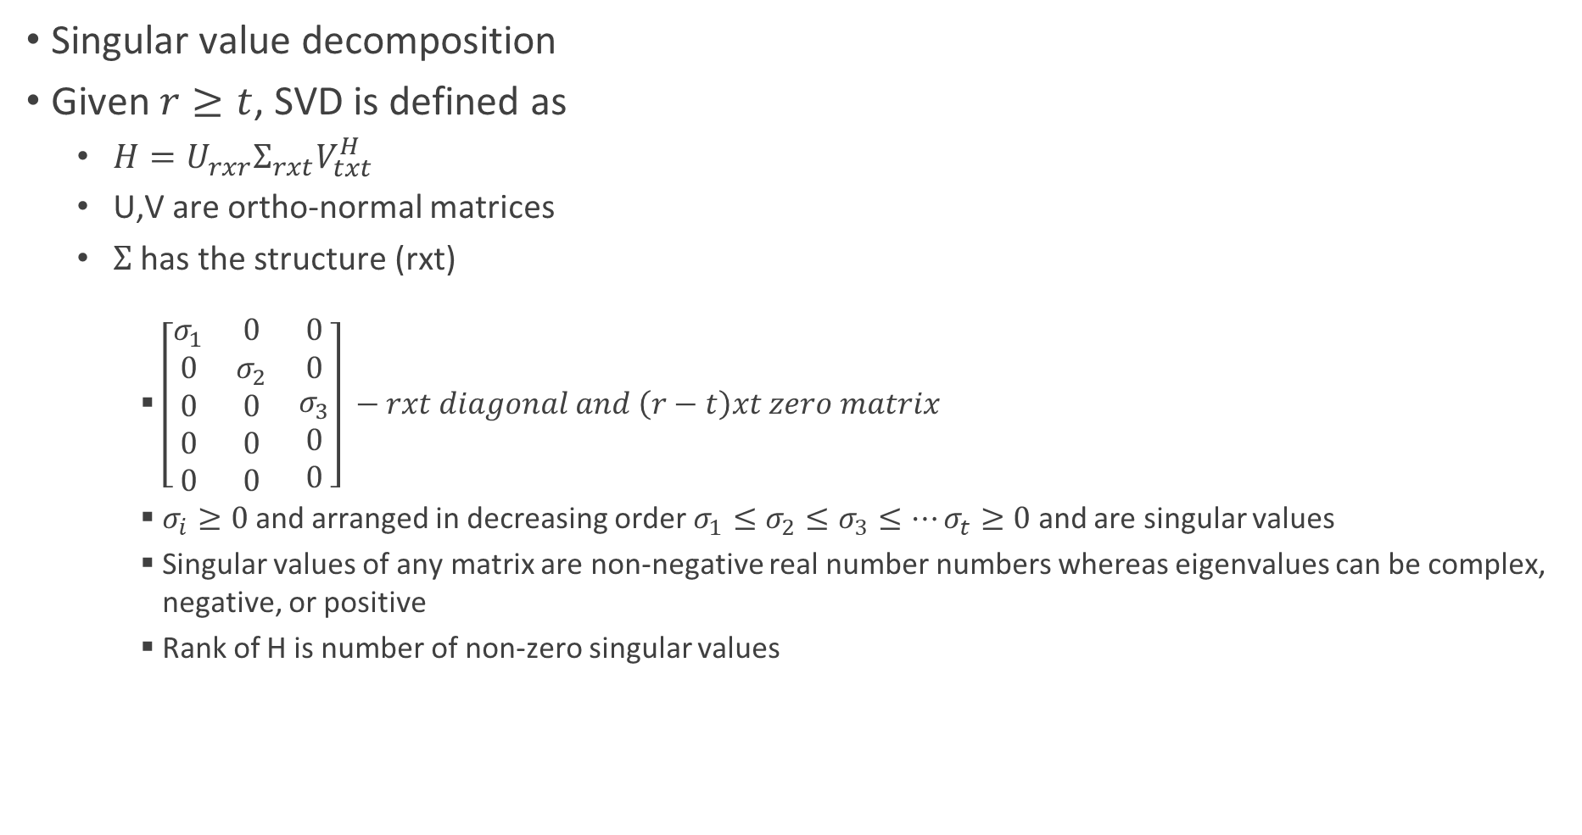
SVD
Singular value decomposition
Given $r≥t$, SVD is defined as
$H=U_{rxr}Σ_{rxt}V_{txt}^{H}$
U,V are ortho-normal matrices
$Σ$ has the structure (rxt)
$\left[\begin{matrix}σ_{1} & 0 & 0 \\ 0 & σ_{2} & 0 \\ \begin{aligned}0 \\ 0 \\ 0\end{aligned} & \begin{aligned}0 \\ 0 \\ 0\end{aligned} & \begin{aligned}σ_{3} \\ 0 \\ 0\end{aligned}\end{matrix}\right] −rxt diagonal and \left(r−t\right)xt zero matrix$
$σ_{i}≥0$ and arranged in decreasing order $σ_{1}≤σ_{2}≤σ_{3}≤…σ_{t}≥0$ and are singular values
Singular values of any matrix are non-negative real number numbers whereas eigenvalues can be complex, negative, or positive
Rank of H is number of non-zero singular values

Slide 23

SVD Relation to Eigenvalue Decomposition
$H^{H}H=V\left[\begin{matrix}σ_{1}^{2} & ⋯ & 0 \\ ⋮ & ⋱ & ⋮ \\ 0 & ⋯ & σ_{t}^{2}\end{matrix}\right]$
$σ_{1}^{2}, σ_{2}^{2}, σ_{3}^{2}…σ_{t}^{2}$ are non-zero eigenvalues of $H^{H}H$
V contains eigen vectors $v_{1}, v_{2},v_{3},…v_{t}$ of $H^{H}H$
$σ_{1}^{2}, σ_{2}^{2}, σ_{3}^{2}…σ_{t}^{2}$ are non-zero eigenvalues of $HH^{H}$
U contains eigen vectors $u_{1}, u_{2},u_{3},…{u }_{t}$ of $HH^{H}$

Slide 24
SVD Processing

Slide 25
Capacity of MIMO Wireless Systems

Slide 26
Alamouti Code

Slide 27
BER of Alamouti Code

Slide 28
Multi-carrier Modulation

Slide 29
OFDM

Slide 30
OFDM System Model

Slide 31
OFDM Examples

Slide 32
BER Performance of OFDM Systems

Slide 33
MIMO-OFDM

Slide 34
ISI Channel Model

Slide 35
Doppler Shift

